Slide 1
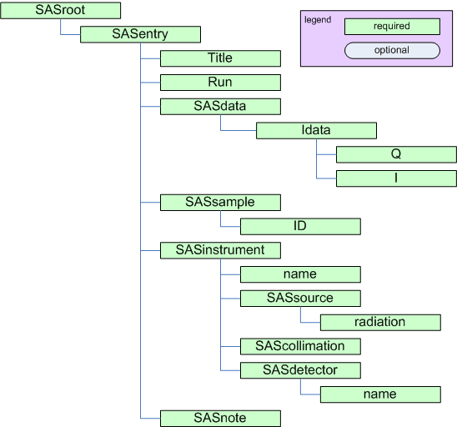
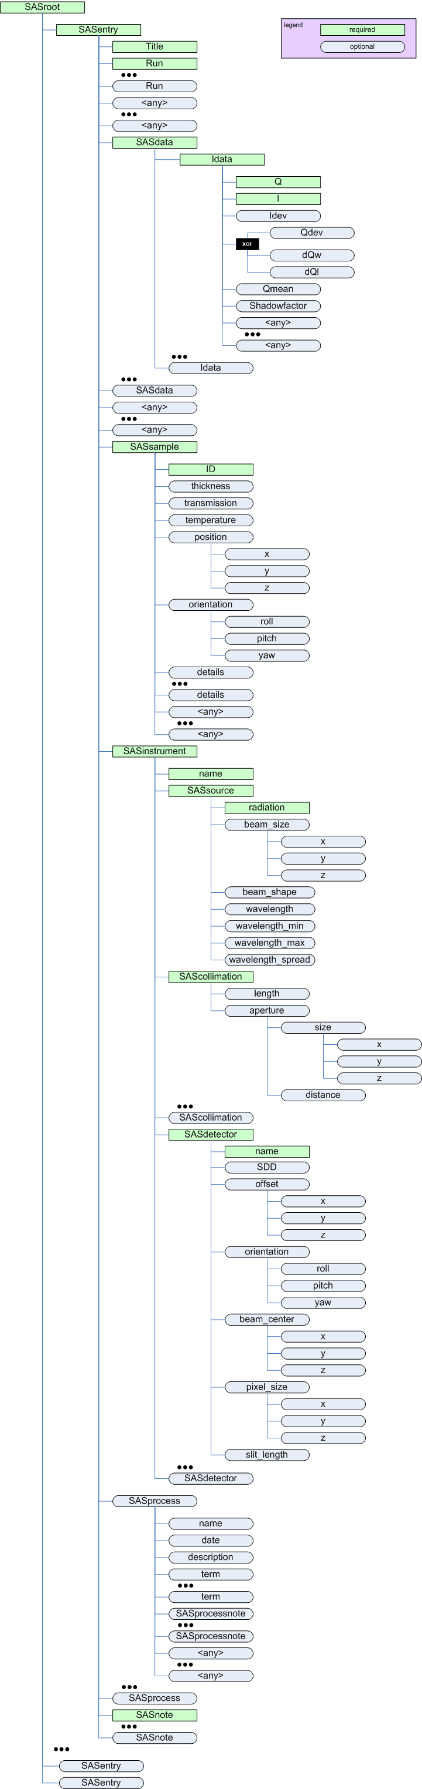
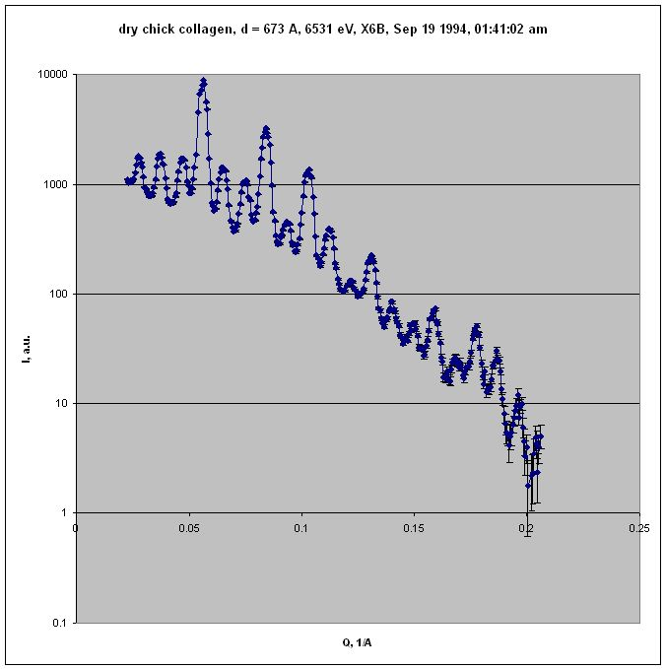
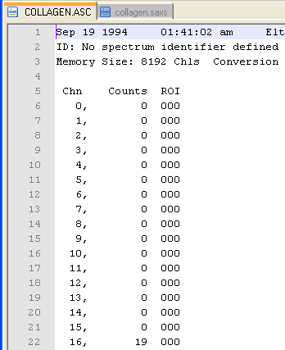
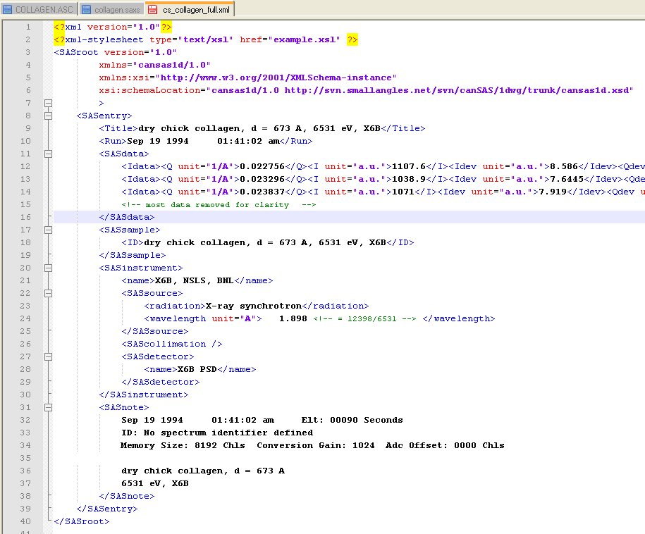
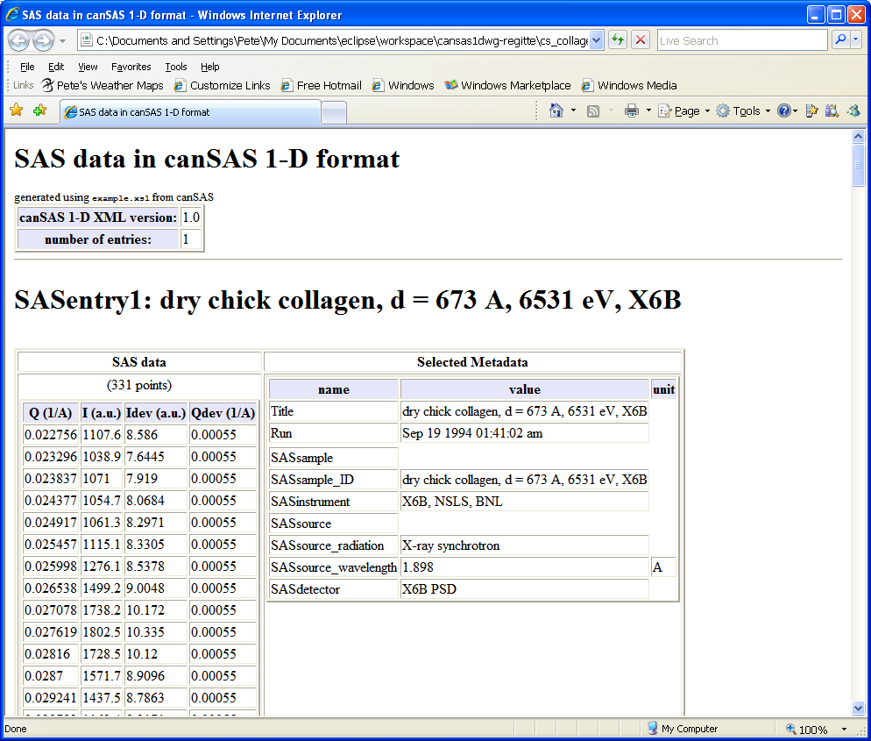
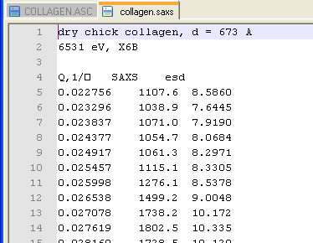
Argonne National Laboratory Users Week 2008, May 4-8, 2008
Upgrade the standard text data file:
The canSAS standard for storing reduced one-dimensional small-angle scattering data in XML files
Pete R. Jemian (APS), Andrew J. Jackson (NIST), Stephen M. King (ISIS), Ken C. Littrell (HFIR), Andrew R.J. Nelson (ANSTO), Ron E. Ghosh (ILL), Jan Ilavsky (APS)
Abstract
One of the first aims of the canSAS (Collective Action for Nomadic Small-Angle Scatterers, www.smallangles.net) forum of users and facility staff was to discuss better sharing of SAS data analysis software. CanSAS identified that a significant need within the SAS community is satisfied by standardizing a robust, self-describing, text-based format to communicate reduced one-dimensional small-angle scattering data, I(Q), between users of our facilities. Our goal has been to define such a format with minimal verbosity that leaves the data file instantly human-readable, editable in simple editors, and importable by simple text import filters in programs that need not recognize advanced structure in the file nor require advanced programming interfaces. The file should contain the primary data, I(Q), and also any other descriptive information (metadata) about the sample, measurement, instrument, processing, or analysis steps.
The cansas1d/1.0 standard meets the objectives for a 1D standard, incorporating experiment metadata, and parameters and results of processing or analysis steps. Even multiple measurements may be included within a single XML (or SASXML) file.
Why XML?
  data description language
  not a file format
  can be used to represent any data structure
  Used by business
  Extensible by design
  Lots of tools available
  Easy to translate using XSLT
XML Schema Definition (XSD) language
  strong data typing
  syntax constraints
  XSD written using XML
  validate XML files
Feature set of canSAS standard
  Reduced 1-D SAS data
  Metadata
  Related data sets
  Engineering units
  Record of processing or analyses steps
What data is this format good for?
  Reduced 1-D SAS data
  ASAXS
  Multiple samples
  Same sample, multiple conditions
  Complementary studies
minimum elements required
for cansas1d/1.0 standard
Block diagram of
cansas1d/1.0 standard
Anybody else using XML?
  NeXus (HDF and XML supported)
  GAML: Thermo Fisher Scientific
    Bruker
    Rigaku
  XRDML: Powder Diffraction (PANalytical)
What tools can read canSAS XML files?
  IgorPro, Excel, WWW browsers
  Any language with text file support
  Any language with XML support is easier
  XSLT can be used to output CSV
  Translator to NeXus has been demonstrated
Example: SAXS from dry chick collagen
Before
After
raw data
Example XML file
(most SAXS data removed for clarity)
Example XML file translation
(HTML display)
reduced data
+ lab notebook
All available metadata included and described
Engineering units specified
Comments and Conclusions
Good idea long time in the making
Agreement on standard between many user facilities
Flexible design tailored for specific community (small-angle)
Perceived competition with other standards bodies (NeXus)
Format allows access to data by variety of methods
All objectives of canSAS 1-D working group have been met
XML is a good method to store scientific data
Rich tools & support exist
http://www.smallangles.net/wgwiki/index.php/cansas1d_documentation

